Slide 1

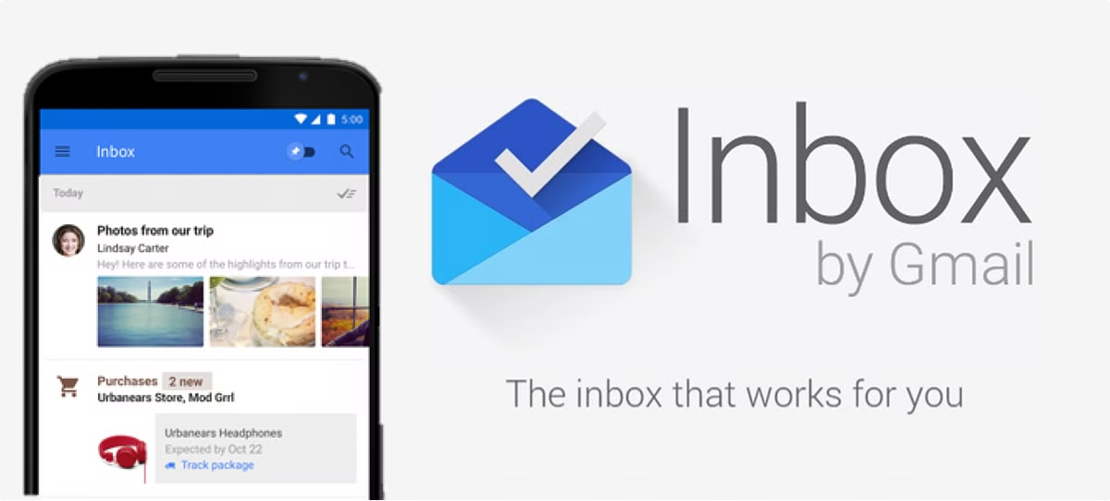
Ham and Spam Classifier
Sparsh Barse
Ananya Agrawal

Slide 2

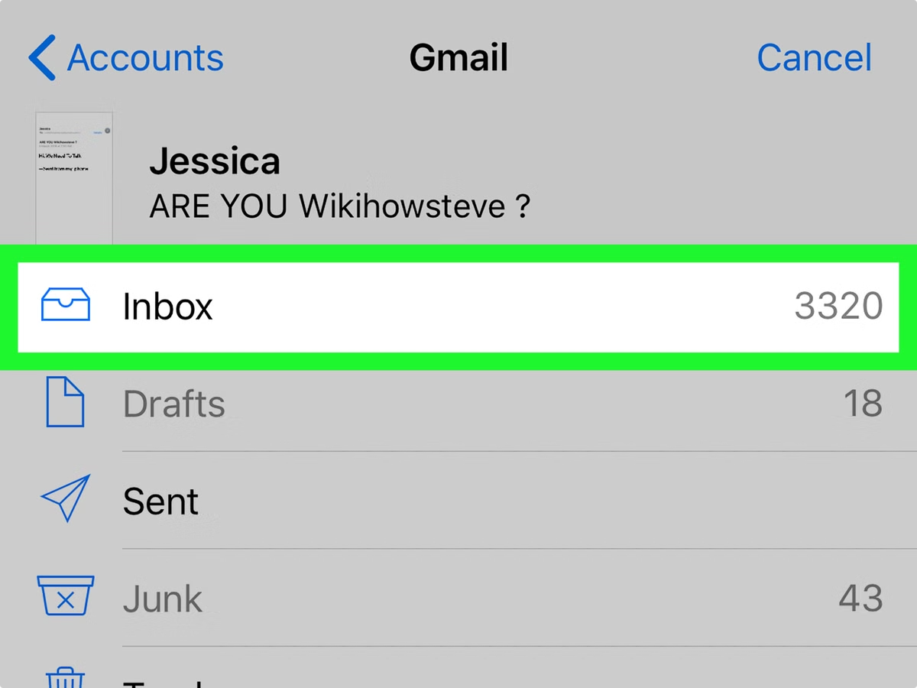
Introduction to Email Classification
1
Importance of Email Filtering
2
Defining Ham and Spam
Email has become an essential communication tool, but the rise of spam emails poses a significant challenge.
Ham refers to legitimate emails, while spam encompasses unsolicited, unwanted, or potentially malicious messages.
3
Automated Classification
Machine learning algorithms can be used to build intelligent email filters that distinguish ham from spam.

Slide 3
Understanding Multinomial Naive Bayes
Probabilistic Approach
Feature Importance
Efficiency and Scalability
Multinomial Naive Bayes is a popular algorithm for text classification tasks like email filtering.
The algorithm considers the frequency of words in emails to determine the probability of a message being ham or spam.
Multinomial Naive Bayes is computationally efficient, making it well-suited for real-world email classification scenarios.

Slide 4

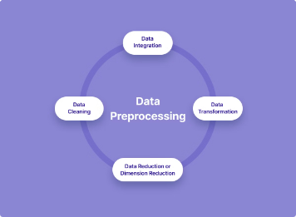
Preprocessing Email Data
Data Cleaning
Feature Extraction
Remove HTML tags, URLs, and other irrelevant information from email text.
Convert email text into a numerical format that can be used for machine learning.
1
2
3
Text Normalization
Convert all text to lowercase and perform stemming or lemmatization.

Slide 5

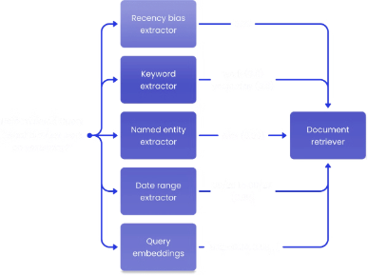
Extracting Features from Emails
Bag-of-Words
TF-IDF
Create a vocabulary of unique words in the email corpus and use word counts as features.
Apply Term Frequency-Inverse Document Frequency to capture the importance of words in emails.
Word Embeddings
Metadata
Use pre-trained word embeddings to capture semantic relationships between words in emails.
Incorporate email metadata such as sender, subject, and timestamp as additional features.

Slide 6


Training the Multinomial Naive Bayes Model
1
Split Data
Divide the email dataset into training and testing subsets to evaluate model performance.
2
Fit the Model
Use the training data to estimate the parameters of the Multinomial Naive Bayes classifier.
3
Make Predictions
Apply the trained model to the testing data to classify emails as ham or spam.

Slide 7



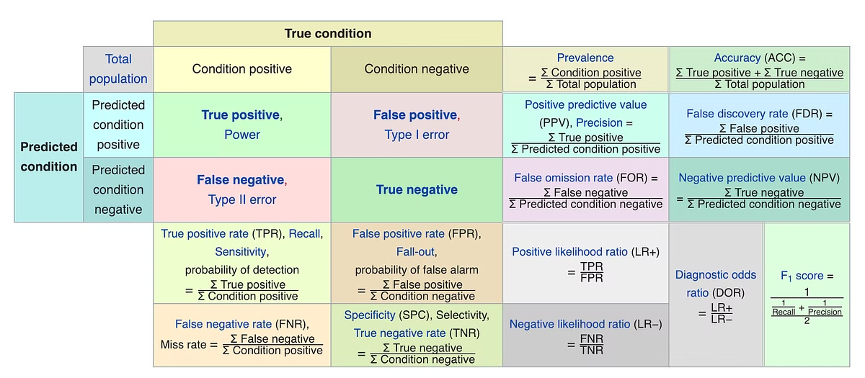


Evaluating Model Performance
Accuracy
Precision
Measure the overall proportion of correctly classified emails.
Assess the model's ability to correctly identify spam emails.
Recall
F1-Score
Evaluate the model's capability to detect all spam emails.
Combine precision and recall into a single metric for overall performance.

Slide 8

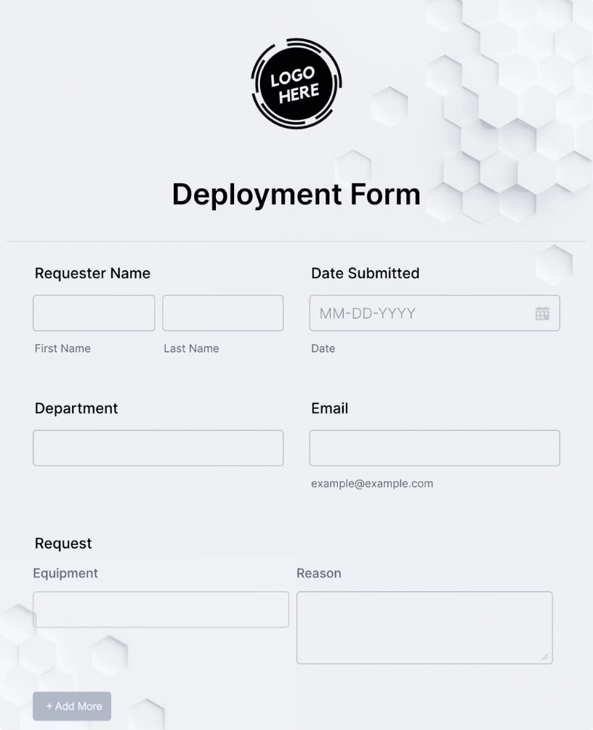
Real-World Application and Deployment
Scalability
Ensure the model can handle large volumes of incoming emails in a timely manner.
Integration
Seamlessly integrate the classifier into existing email infrastructure or workflows.
Monitoring
Continuously monitor model performance and update the classifier as needed.
User Experience
Provide a clear and intuitive way for users to understand and trust the email classification.

Slide 9
Conclusion and Future Improvements
Summary
Future Enhancements
Ongoing Maintenance
In this presentation, we've explored the development of a robust ham and spam classifier using Python and Multinomial Naive Bayes.
Explore advanced techniques like deep learning, ensemble methods, and incorporating user feedback to further improve classification accuracy.
Regularly update the model to adapt to evolving spam tactics and maintain high-performance standards.

